Slide 1
CSc 553 Principles of Compilation 02. Background: Symbol Tables
Saumya Debray
The University of Arizona
Tucson, AZ 85721

Slide 2
Symbol Tables
A symbol table keeps track of information about names in the program
when a name is encountered during compilation, it is looked up in the symbol table
there is usually a different symbol table for each different scope (e.g., global vs. local)
Information includes things like:
type
no. of elements (arrays); no. and types of arguments (functions);
...

Slide 3
Symbol Tables
source
program
front end
intermediate code generator
analyzer
+
optimizer
final code generator
target
program
symbol table manager

Slide 4
Information needed about names
Type checking:
Given the code y = f(u,v,w) :
is f a function?
no. of arguments OK?
argument types OK?
Code generation:
Given the code x = y + z :
where in memory are x, y, z?
how much space do they occupy? (byte/word/...)

Slide 5
Symbol Tables
Purpose: To hold information about identifiers that is computed at one point and used later.
E.g.: type information:
computed during parsing;
used during type checking, code generation.
Operations:
create, delete a symbol table;
insert, lookup an identifier
Typical implementations: linked list, hash table.

Slide 6
Symbol Tables
scope₀ (global)
Each distinct scope in the program has its own symbol table
for names local to that scope
Symbol table entries are typically created when processing declarations
(also: some when generating code)
int fact(int fact)
{
int i = 1, prod = 1;
while (fact > 0)
{
{
int fact;
fact = prod * i;
prod = fact;
}
fact = fact - 1;
i = i + 1;
}
return prod;
}
scope₁
scope₂
scope₃

Slide 7
Symbol Tables
What does a symbol table entry look like?
“xyz”
name
type info
info related to code generation (e.g., location)
next/prev pointer(s)
e.g.:
int
array:
element-type = char
no. of elements = 10
function:
argument types: …
return type: …

Slide 8
Symbol Tables
Information is filled in as it becomes available
“xyz”
name
type info
info related to code generation (e.g., location)
next/prev pointer(s)
filled in when processing
declarations (during semantic
checking)
filled in during code generation

Slide 9
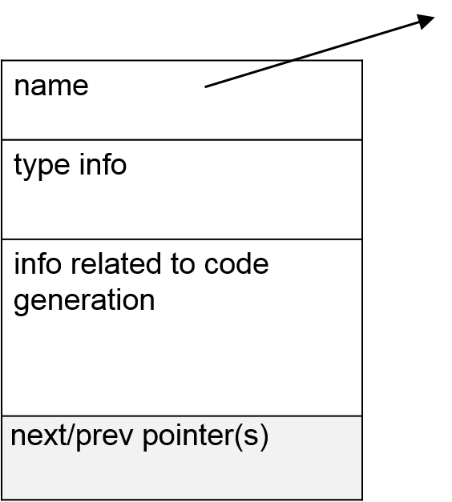
Symbol Tables
What does a symbol table look like?
“foo”
“bar”
“bas”
“baz”
symtab_hd
Note: Any data structure that allows insertion and lookup based on the symbol name will do.
E.g.: linked list, hash table, binary search tree, …

Slide 10
Managing Symbol Tables
When looking up a name in a symbol table, we need to find the “appropriate” declaration.
The scope rules of the language determine what is “appropriate.”
Often, we want the most deeply nested declaration for a name.
Implementation: for each new scope: push a new symbol table on entry; pop on exit (stack).
implement symbol table stack as a linked list of symbol tables;
newly declared identifiers go into the topmost symbol table.
lookup: search the symbol table stack from the top downwards.

Slide 11
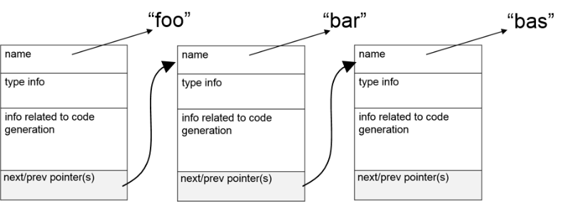
Managing Symbol Tables
SCOPE 0
push symbol table for scope 0
int foo, bar, bas;
foo = …
bar = …
if (foo > bar)
{
int foo, bar, bas;
bar = …
bas = …
while (bar != bas)
{
int foo, bar, bas;
…
}
}
NULL
symtbltop

Slide 12
Managing Symbol Tables
SCOPE 0
int foo, bar, bas;
foo = …
bar = …
if (foo > bar)
{
int foo, bar, bas;
bar = …
bas = …
while (bar != bas)
{
int foo, bar, bas;
…
}
}
NULL
symtbltop
SCOPE 1
push symbol table for scope 1
symtbltop

Slide 13
Managing Symbol Tables
SCOPE 0
int foo, bar, bas;
foo = …
bar = …
if (foo > bar)
{
int foo, bar, bas;
bar = …
bas = …
while (bar != bas)
{
int foo, bar, bas;
…
}
}
NULL
SCOPE 1
symtbltop
SCOPE 2
push symbol table for scope 2
symtbltop

Slide 14
Managing Symbol Tables
SCOPE 0
int foo, bar, bas;
foo = …
bar = …
if (foo > bar)
{
int foo, bar, bas;
bar = …
bas = …
while (bar != bas)
{
int foo, bar, bas;
…
}
}
NULL
SCOPE 1
symtbltop
SCOPE 2
symtbltop
pop symbol table for scope 2

Slide 15
Managing Symbol Tables
SCOPE 0
int foo, bar, bas;
foo = …
bar = …
if (foo > bar)
{
int foo, bar, bas;
bar = …
bas = …
while (bar != bas)
{
int foo, bar, bas;
…
}
}
NULL
symtbltop
SCOPE 1
symtbltop
SCOPE 2
pop symbol table for scope 1

Slide 16
Symbol Table Lookups
In statically scoped languages (C, Java, …), each use of an identifier refers to the most deeply nested declaration enclosing that use
At a use of an identifier, the symbol table is looked up to find its declaration:
start at the symbol table most deeply nested scope (i.e., at the top of the symbol table stack)
while not found: work down the symbol table stack, searching each symbol table in the stack

Slide 17
Symbol Table Lookups
int x, y;
x = …
y = …
if (x > y) {
float x = y + 3.1412;
y = 2.0 * x – 1.0;
}
else {
x = y+1;
}

Slide 18
Symbol Table Lookups
SCOPE 0
int foo, bar, bas;
foo = …
bar = …
if (foo > bar)
{
int foo, bar, bas;
bar = …
bas = …
while (bar != bas)
{
int foo, bar, bas;
…
}
}
NULL
SCOPE 1
SCOPE 2

Slide 19
EXERCISE
Given the following stack of symbol tables:
in which symbol table will a lookup find:
xyz
pqr
uvw
st0
st1
st2
st3
abc
cde
xyz
direction of
stack growth
pqr
xyz
uvw
pqr
abc
fgh
cde
uvw
top of stack

